Slide 1
CRYPTO_SPHERE
A gateway to the world
of CRYPTO
BIKRAM DEBNATH
14400119018
Reg No. 034912 of 2019-20
SUBHASISH NEGEL
14400119044
Reg No. 033840 of 2019-20
SUBHAM MAITY
14400119043
Reg No. 034208 of 2019-20
Supervised By_
Prof. Debabrata Nath

Slide 2
OBJECTIVE
Our main objective is to create dApp designed for normal users who want to send cryptocurrency to each other through an app, and the process will be extremely straightforward. Normal people can also perform a large number of tasks on our web3 platform, which will assist them with investment tips, help them make investments more profitable with our artificial intelligence, and offer them a variety of features. Using Machine Learning, predict future crypto prices and know when to sell, reducing the risk for traders.

Slide 3
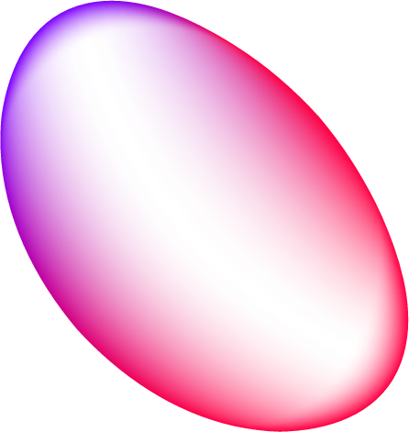

Short Introduction
Crypto Details
01
Crypto Exchange
02
Crypto Predict
03
NFT Marketplace
04
Trading requires perfect Crypto Details, that’s why you need an online service that provides up to date news and details regarding each cryptocurrency
The exchange also has supporting services for users to earn interest or transact using cryptocurrencies.
Using Machine Learning a summary of previous market data can help you predict the future price of your investment and ensure its profitability
A blockchain-based online platform to sell and buy non-fungible tokens (NFTs).

Slide 4
Proposed Method
CoinCryptX solution is developed with high-security standards and multiple payment method. We’ll use custom hooks and utility functions to manage the state of our application.Compile and deploy our own smart contracts on the ethereum blockchain We will use Cranq, a graphical and intuitive IDE that’ll allow us to compile and deploy our smart contracts.
To predict the future price, we use advance machine learning algorithm and also Pandas, Pandas Datareader, Yahoo Finance, Facebook Prophet and Plotly to aid us in the process.
Create and mint our own NFT Tokens using the ThirdWeb SDK. Adding Web 3.0 authentication using Metamask. Storing data and information about the tokens user created in Sanity.io Using GROQ to retrieve data from Sanity Studio and display it in our NFT Marketplace App. Creating a send and receive functionality for our NFTs on the blockchain

Slide 5
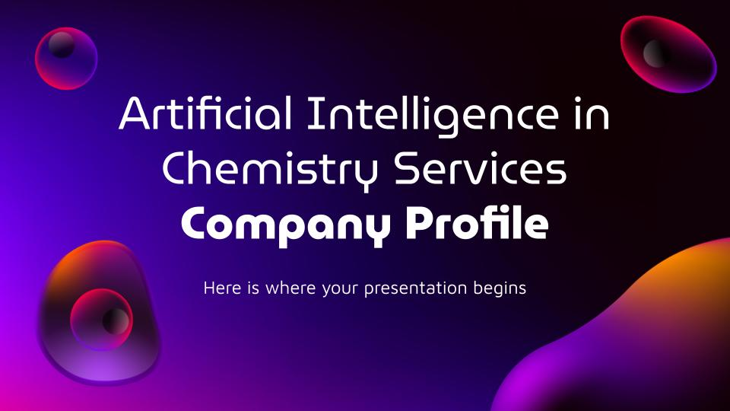
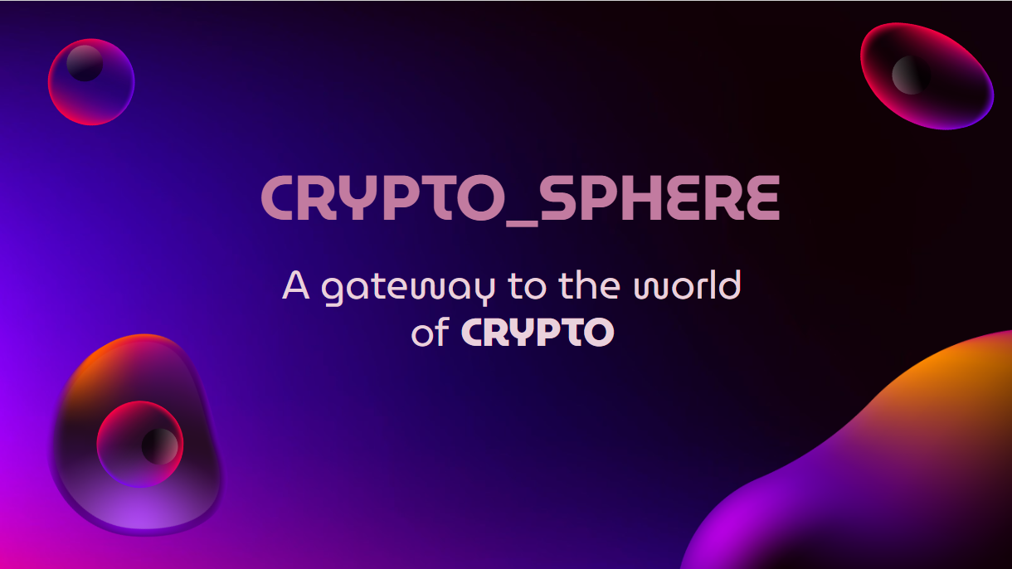
Result
The adoption of technology depends on the requirements of the business here in the case is for the payment system. The no of profits margin derives the adoption of technology. Most of the Banks around the globe have adopted blockchain as they value customer's privacy in the first place. There are always pros and cons related to each technology which goes the same in the case of blockchain too. They only problem with technology is the cost. The cost drives the business day to day operations, so this is where the banks have to think carefully before the adoption of this technology. The blockchain based payment system becomes more temper proof when it is powered by blockchain.

Slide 6
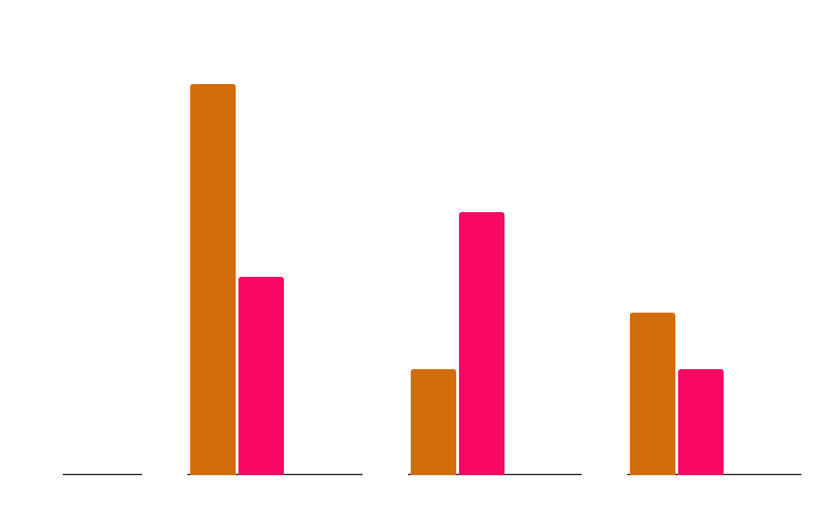
Conclusion
Crypto Sphere, a decentralized, distributed ledger that securely records digital transactions, has been
met with high expectations due to its potential to disrupt business models and financial systems
Crypto
NFT
Web3
Crypto Sphere
2024
2023
2022

Slide 7
Future Scope
Blockchain technology is revolutionary. It will make life simpler and safer, changing the way personal information is stored and how transactions for good and services are made. Blockchain technology creates a permanent and immutable record of every transaction
WORLDWIDE SPENDING ON BLOCKCHAIN SOLUTIONS FROM 2021 TO 2024
Years | Percentage of growth | Us Dollars
2021 |  | $78.5m
2022 |  | $134.41m
2023 |  | $230.89m
2024 |  | $688.13m
11%
27%
50 %
74%

Slide 8
Reference
Our Own Documentation Website : CodeXam – Best Coding Learning Platform (code-xam.vercel.app)
Additional:
Streamlit documentation
Quick Start | Prophet (facebook.github.io)
Remix - Ethereum IDE & community (remix-project.org)
Ethereum.org
Next.js by Vercel - The React Framework (nextjs.org)
The Platform For Structured Content - Sanity.io
thirdweb: The complete web3 development framework
Accelerating Systems with Real-time AI Solutions - Groq
Solidity — Solidity 0.8.17 documentation (soliditylang.org)
Ganache - Truffle Suite
Corda | Leading DLT Platform for Regulated Industries

